Slide 1
Challenging Algebra Problems (Solutions)

Slide 2

1st METHOD
Fast way to do this question is replace “a” and “b” with actual numbers. Note: Pick easy numbers
“a” is even, so “a” is equal to 2. “b” is odd, so “b” is equal to 3
Plug in the value to each answer and see which one is ODD
ANSWER is “E”
2nd Method:
Use Logic: 1. An even number times Odd number is even
2. Any number times 2 is always even
3. The sum of two or more even numbers is always even
4. The sum of two ODD numbers is Even
ANSWER is “E”
Which means that a, b, c, and d are all even

Slide 3
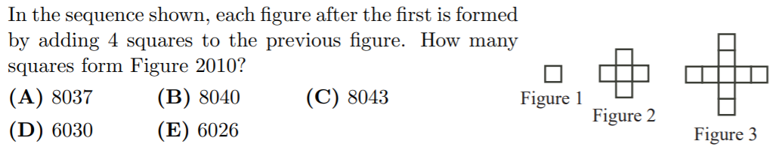
Come up with a quick pattern, where the number of squares is equal to the “center” plus the length of the wings
Figure 1: n = 1
Number of blocks is “center” plus 4 x 0 wings
Figure 2: n = 2
Number of blocks is “center” plus 4 x 1 wings
Figure 3: n = 3
Number of blocks is “center” plus 4 x 2 wings
Figure 4: n = 4
Number of blocks is “center” plus 4 x 3 wings
Figure 2010: n = 2010
Number of blocks is “center” plus 4 x 2009 wings

Slide 4
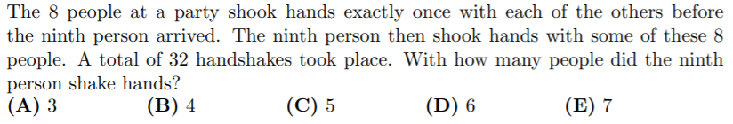
With the 8 people, the number of handshakes is 28.
IT takes 2 people to have a single handshake
There are 8 people, so each person has 7 handshakes
Again, every 2 handshakes is actually ONLY 1 proper handshake
This leaves 4 handshakes left for the 9th person

Slide 5
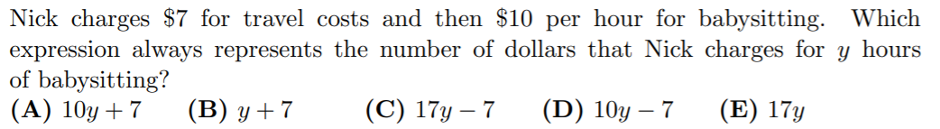
Answer is “A” for this one…. easy

Slide 6
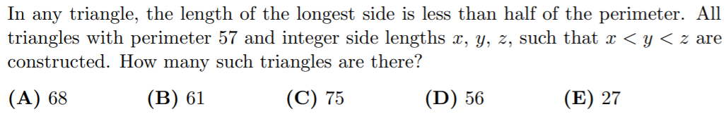
Smallest Y
This one is NOT easy…. Try to come up with a system to count
Smallest number
Y + Z
Start with the case where all three are as close as possible
This gives us 18, 19, 20
Use the smallest number in the set to count how many possibilities for the two larger numbers
So make a chart to organize your work
“Y” must be bigger than the smallest number and it must be LESS than half the remaining sum

Slide 7
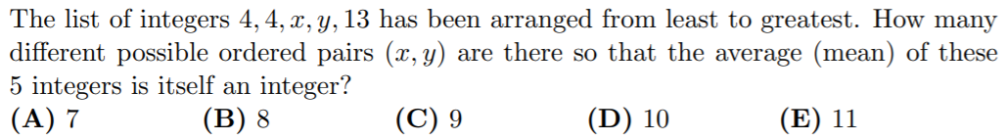
The sum of all five numbers MUST be a multiple of 5 for the average to be an integer
So we have different sums for “x” and “y”
We have 11 cases in total!!

Slide 8
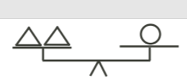





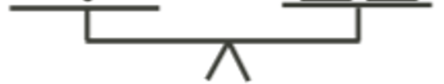
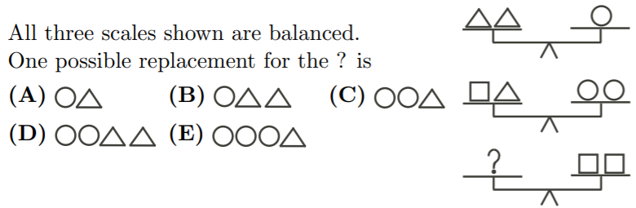
REVERSE two first scales and then combine it with the second scale!
Cancel out anything on both sides!
So ONE square is equal to ONE triangle and ONE circle
TWO squares is equal to Two Circles and TWO triangles
Answer “D”

Slide 9
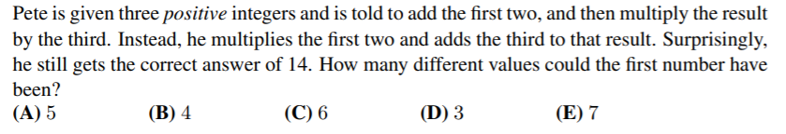
LET a, b, and c be the three positive integers where “a” is FIRST and “c” is LAST
WHAT PETE was TOLD to DO
WHAT PETE DID instead
ANSWER is “B” 4 different values for “a’

Slide 10
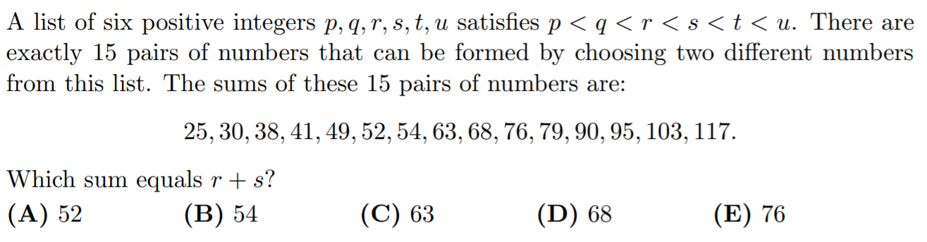
First we need to understand that 6 Choose 2 is 15
IF ‘p” and ‘q” are smallest then
Second: IF we add up all these values, we get:
IF ‘t” and ‘u” are largest then
Which means that:

Slide 11
